Slide 1
AD8152 Assembly Site Transfer and Data Sheet Revision_PCN
Date: 05-02-2019

Slide 2
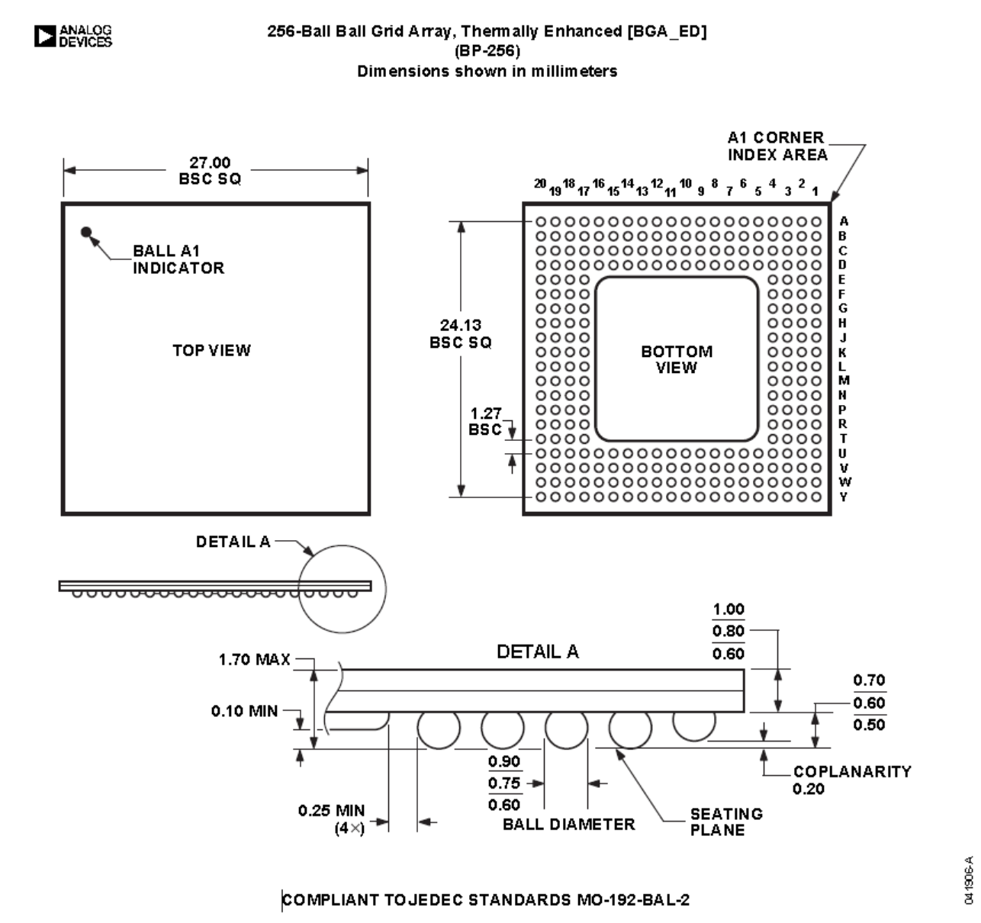
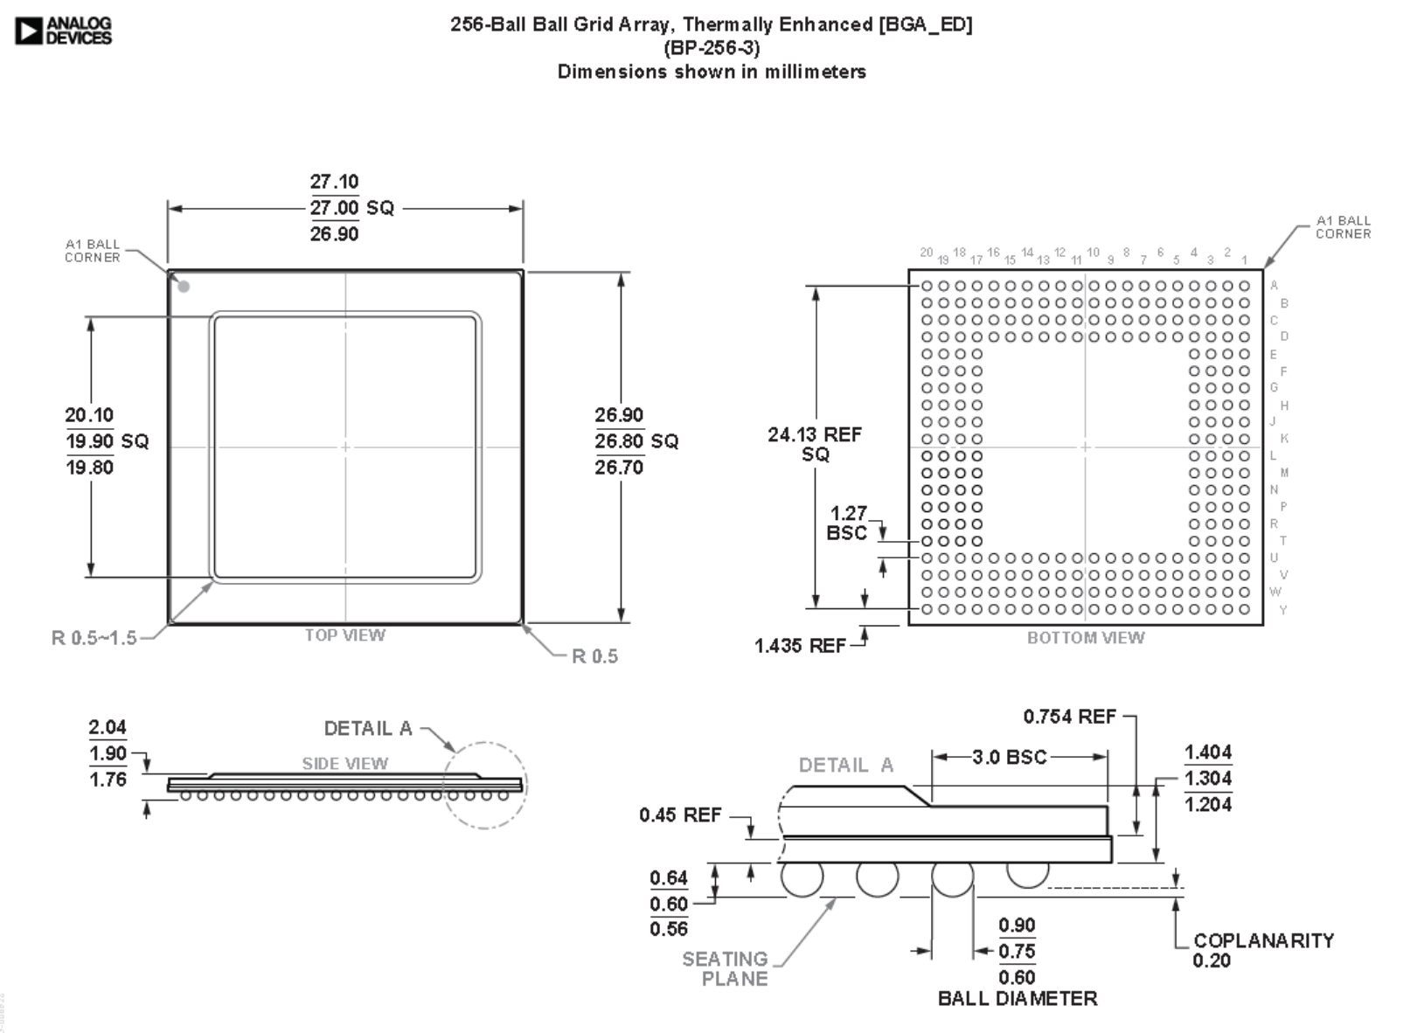
Change #1- Package Outline Drawing
New POD→ BP-256-3
2.04mm max height
Current POD→ BP-256
1.7mm max height

Slide 3
Change #2 – Die Interconnect
Current package uses wire bonded die
New package uses flip chip die with solder bumps

Slide 4
Change #3 Assembly Site
New assembly site is STATS ChipPAC Korea

Slide 5
Change #4- Data Sheet Change
Data sheet rev change from RevA to RevB
On page 2, Electrical Characteristics – Removed thermal characteristics section
On page 3, Absolute Maximum Ratings under NOTES 2 – Change θ_{JA} = 15° C/W TO θ_{JA} = 9.2° C/W.
On page 3, added thermal resistance section
On page 31, a new POD BP-256 is replaced by BP-256-3

